Slide 1

Project Title -SEASONAL AGRICULTURE PERFORMANCE ANALYSIS
Student Name: Velampalli Venkata Sai Sujeevan
College Name- Geethanjali Institute of Science and Technology
AICTE STU ID : STU658046cf7f3e11702905551

Slide 2

PROBLEM STATEMENT
Agricultural performance varies across different seasons.
Environmental conditions, resources and farming practices influence crop performance.
Raw agricultural data does not clearly reveal these seasonal differences.
This project analyzes the dataset to identify patterns, trends, relationships and variations across seasons.
The findings can support evidence-based agricultural planning.

Slide 3
Project Description
Analyze agricultural data from different seasons, states, districts and crops
Perform data cleaning and exploratory data analysis.
Compare yield, production and profit across seasons.
Study rainfall, temperature, soil moisture and other environmental factors.
Analyze water, fertilizer and pesticide usage.
Perform univariate, bivariate and multivariate analysis.
Detect outliers and identify important correlations.
Generate data-driven agricultural insights.

Slide 4

WHO ARE THE END USERS?
Farmers – Understand seasonal crop performance.
Agricultural Planners – Improve seasonal planning.
Agricultural Researchers – Study crop and environmental patterns.
Government Departments – Support agricultural planning and policies.
Agribusiness Companies – Analyze production and profitability.
Data Analysts & Students – Perform agricultural data analysis

Slide 5

Technology Used
Programming Language
Python
Libraries
Pandas – Data cleaning and analysis
NumPy – Numerical operations
Matplotlib – Basic charts and graphs
Seaborn – Statistical visualizations
Platform
Jupyter Notebook – Analysis, visualization and documentation

Slide 6
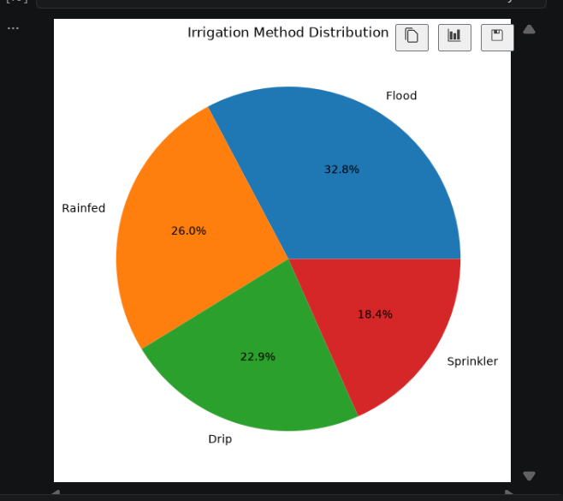
RESULTS -Irrigation Method Distribution
The pie chart shows the distribution of irrigation methods used across the agricultural dataset.

Slide 7
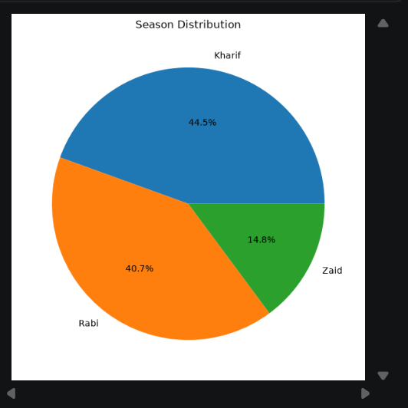
RESULTS -Season Distribution
The pie chart shows the percentage distribution of agricultural records across Kharif, Rabi and Zaid seasons.

Slide 8
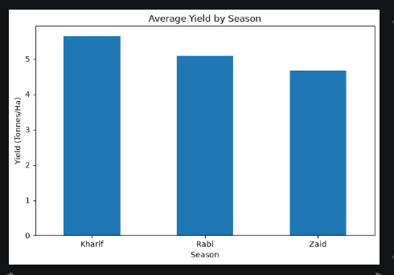
RESULTS -SEASONAL PERFORMANCE
The bar chart compares average agricultural yield across Kharif, Rabi and Zaid seasons.

Slide 9
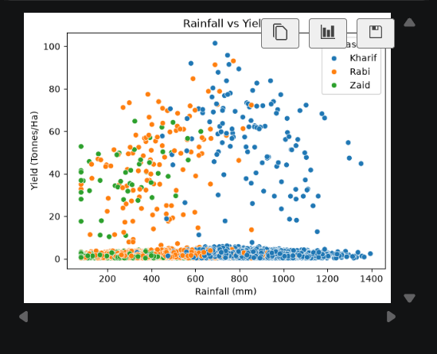
RESULTS -Environmental Analysis
The scatter plot shows the relationship between rainfall and agricultural yield across seasons.

Slide 10
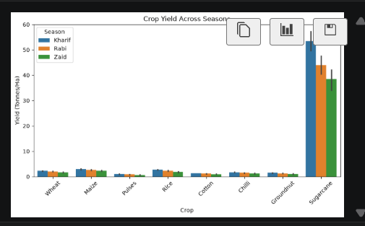
RESULTS -Crop Performance
erformance.
The bar chart compares crop-wise yield across seasons and highlights differences in crop performance.

Slide 11
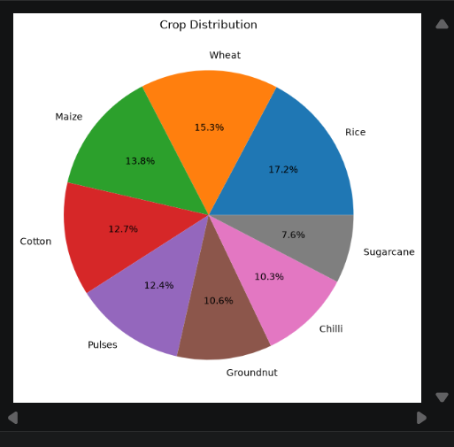
RESULTS -Crop Distribution
The pie chart shows the percentage distribution of different crops in the agricultural dataset

Slide 12
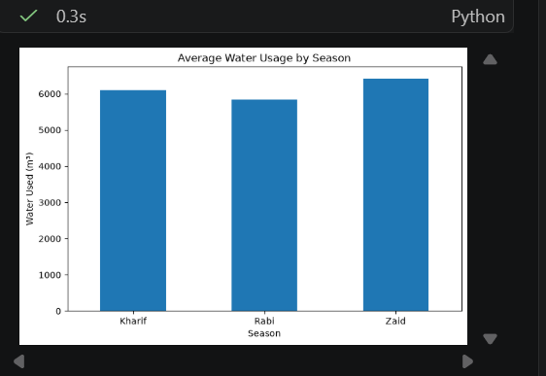
RESULTS -Resource & Economic Analysis
The bar chart compares average water consumption across different agricultural seasons.

Slide 13
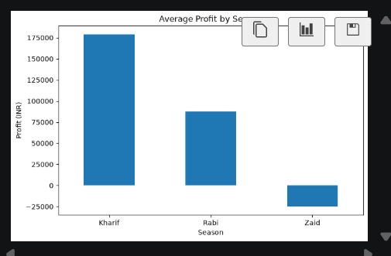
RESULTS -RESOURCE & ECONOMIC ANALYSIS
This is actually better than putting only one graph because the slide demonstrates both resource usage + economic performance.

Slide 14
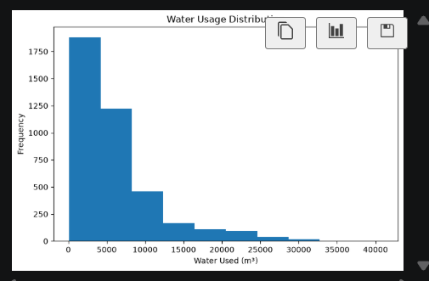
RESULTS -Water Usage Analysis
The histogram shows the distribution and frequency of water usage across agricultural farms.
What bins=10 means
The water-usage values are divided into 10 intervals (bins) to show how frequently different water-usage ranges occur.

Slide 15
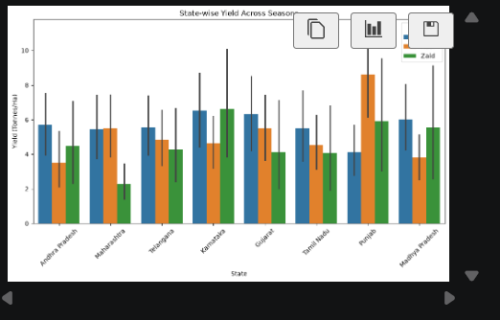
RESULTS -State-wise Seasonal Yield
The bar chart compares yield across different states and seasons to identify regional and seasonal differences in agricultural performance.

Slide 16
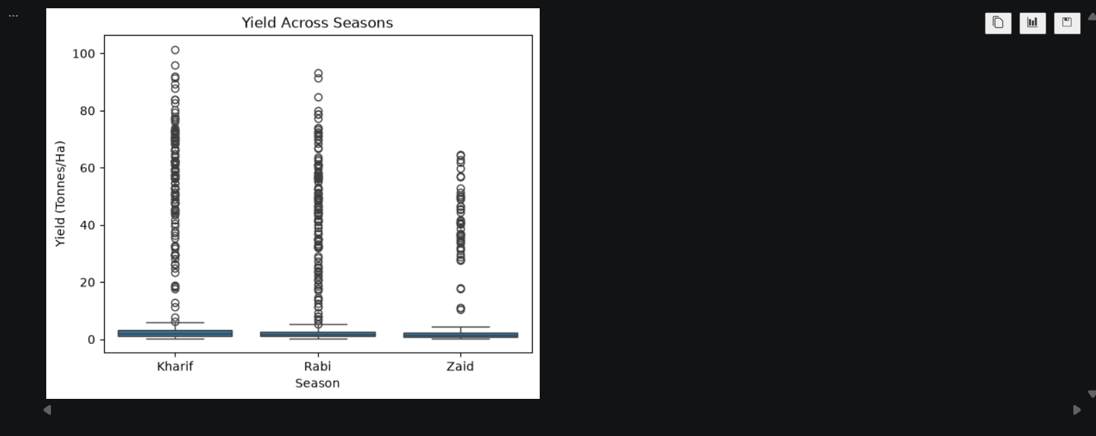
RESULTS -Yield Variation & Outlier Analysis
The box plot compares yield variation across seasons and identifies unusually high or low yield values (outliers).

Slide 17
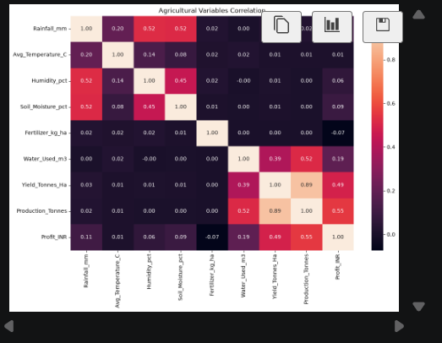
RESULTS -Correlation Heatmap
The correlation heatmap shows the strength and direction of relationships between environmental, resource, production and economic variables.

Slide 18
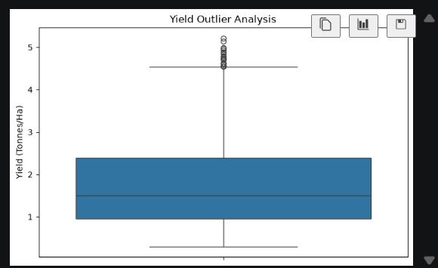
RESULTS -Yield Outlier Analysis
The box plot shows the distribution of agricultural yield and identifies unusually high or low yield values (outliers).

Slide 19
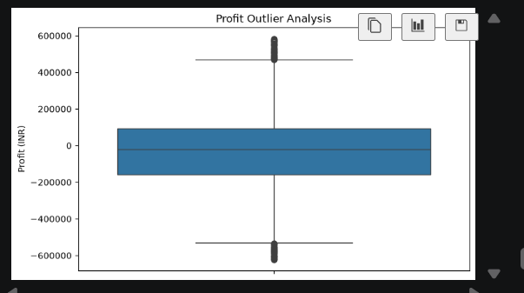
RESULTS -Profit Outlier Analysis
The box plot shows profit variation and identifies unusually high or low profit values in the agricultural dataset.

Slide 20
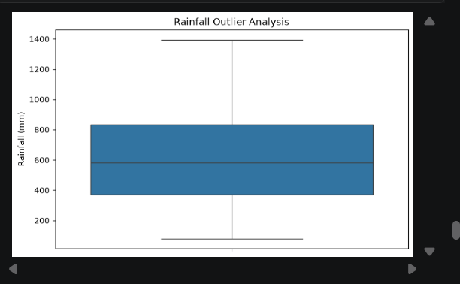
RESULTS -Rainfall Outlier Analysis
The box plot shows rainfall variation and helps identify unusually high or low rainfall observations.

Slide 21
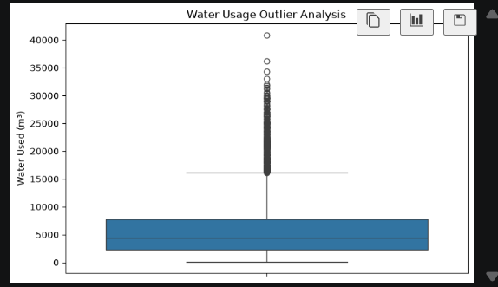
RESULTS-Water Usage Outlier Analysis
The box plot shows the variation in agricultural water usage and helps identify unusually high or low water-use observations.

Slide 22
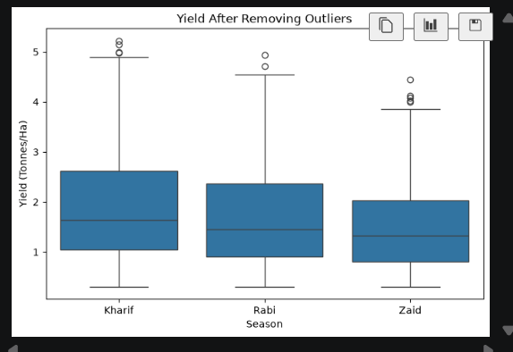
RESULTS-Yield After Removing Outliers
The box plot compares yield distribution across seasons after removing outliers, providing a clearer view of seasonal performance.

Slide 23
Project Outcomes
Successfully analyzed agricultural data across different seasons.
Compared yield, production and profit across seasons.
Identified seasonal variations in rainfall, temperature and soil moisture.
Analyzed water and fertilizer usage.
Studied relationships between environmental conditions and yield.
Identified potential outliers using box plots and IQR analysis.
Generated data-driven insights for seasonal agricultural planning.

Slide 24
Future scope
Develop a machine-learning model to predict crop yield.
Predict agricultural profit based on seasonal conditions.
Recommend suitable crops for different seasons and regions.
Build a dashboard for real-time agricultural analysis.
Integrate weather and rainfall data.
Improve irrigation and fertilizer recommendations.
Use larger datasets for more accurate predictions.

Slide 25
Conclusion
Seasonal factors have a significant role in agricultural performance.
The analysis revealed differences in yield, production and profit across seasons.
Environmental conditions and resource usage were compared using data visualization.
Univariate, bivariate and multivariate analysis helped identify important patterns.
Outlier analysis helped detect unusual observations.
The findings can support better seasonal planning, resource management and agricultural decision-making.

Slide 26
GitHub Link
https://github.com/vvssujeevan234/-Seasonal_Agriculture_Analysis

Slide 27
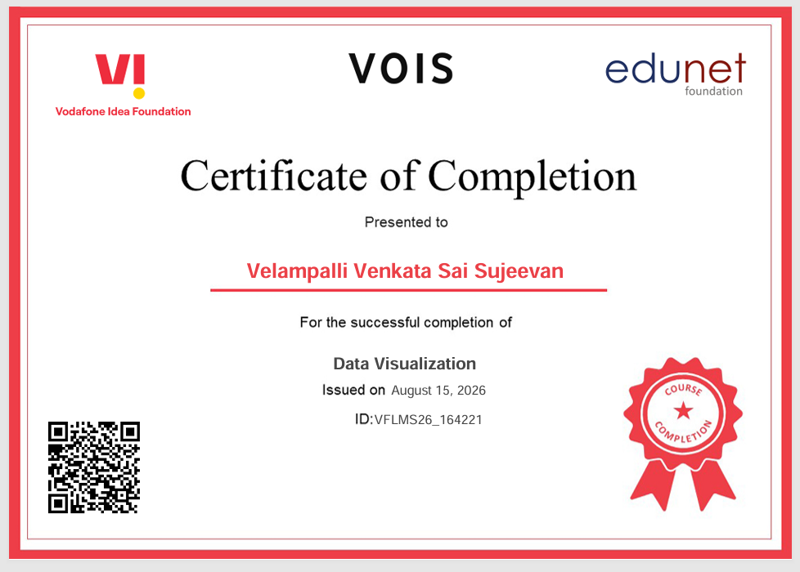
VOIS Course completion certificate - Course name- Data Visualization

Slide 28
Thank you
.
.

